Slide 1

Numerical Chromosome Abnormalities
Basics of Genetics
Dr. Minai
Parmoun Nekounam – 610498181
Mahroo Hajimehdi – 610498118
Ali Akbari Pazouki – 610498212
Mohammad Amin Kiani - 610498160
Spring 1401
University of Tehran, Department of Biological Science

Slide 2
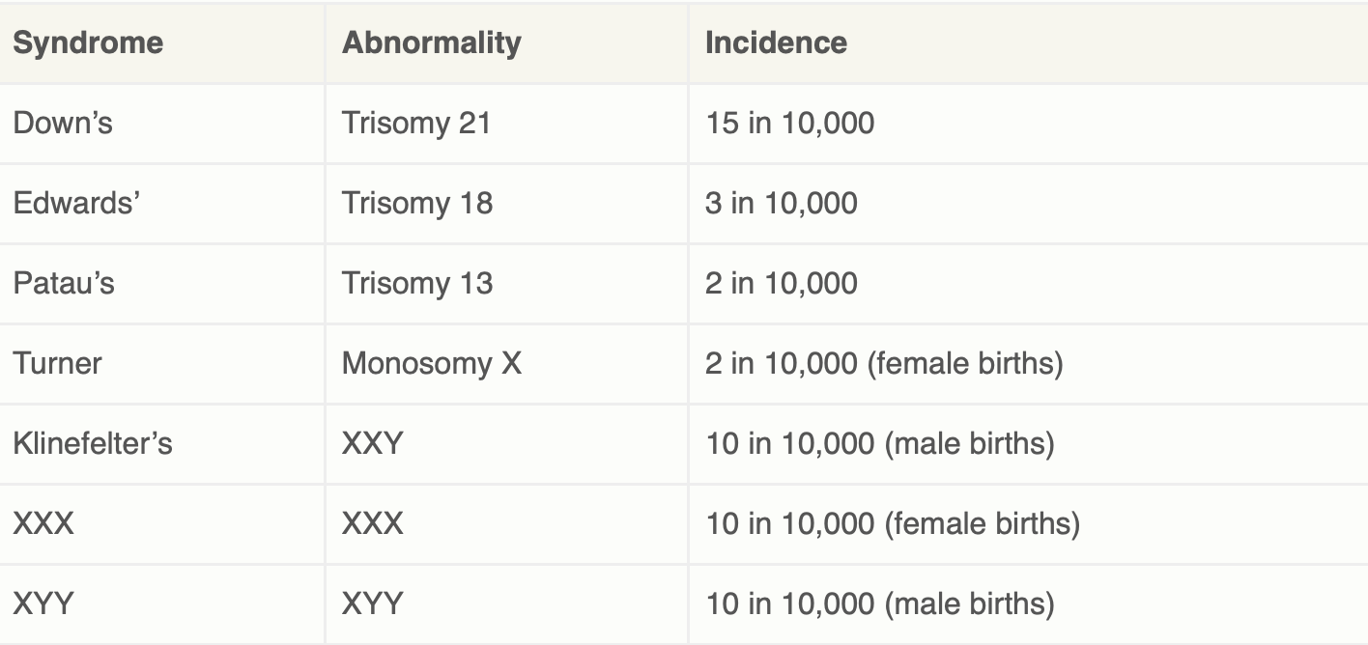
Variation in Chromosome Number: Terminology and Origin
Variation in chromosome number ranges from the addition or loss of one or more chromosomes to the addition of one or more haploid sets of chromosomes.
In the general condition known as aneuploidy, an organism gains or loses one or more chromosomes but not a complete set. The loss of a single chromosome from an otherwise diploid genome is called monosomy. The gain of one chromosome results in trisomy.
The gain (47,XXY) or loss (45,X) of an X chromosome from an otherwise diploid genome affects the phenotype, resulting in Klinefelter syndrome or Turner syndrome, respectively
Such chromosomal variation originates as a random error during the production of gametes, a phenomenon referred to as nondisjunction, whereby paired homologs fail to disjoin during segregation.

Slide 3
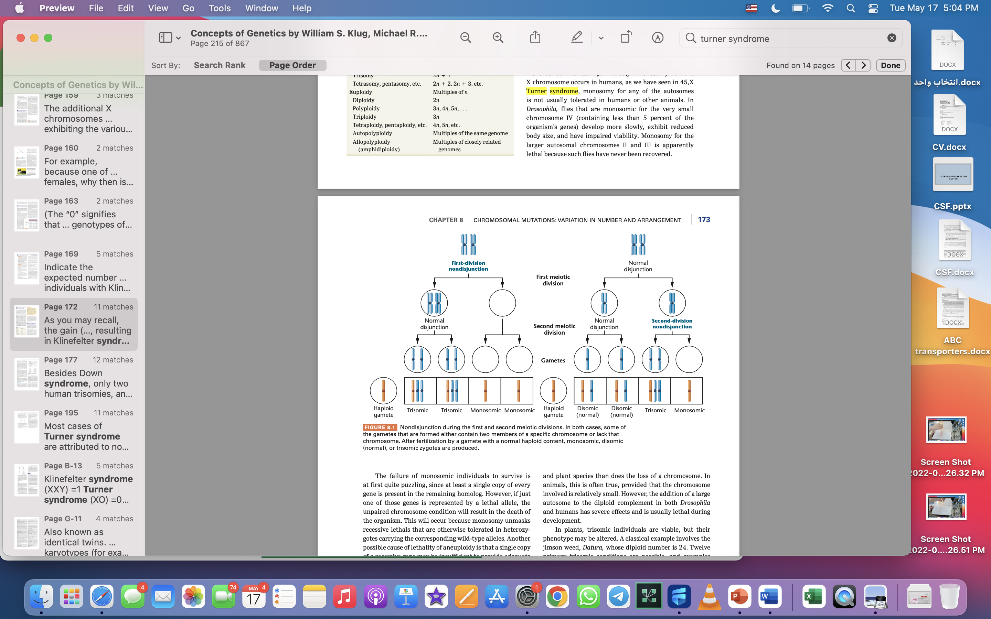
Nondisjunction during the first and second meiotic divisions.

Slide 4
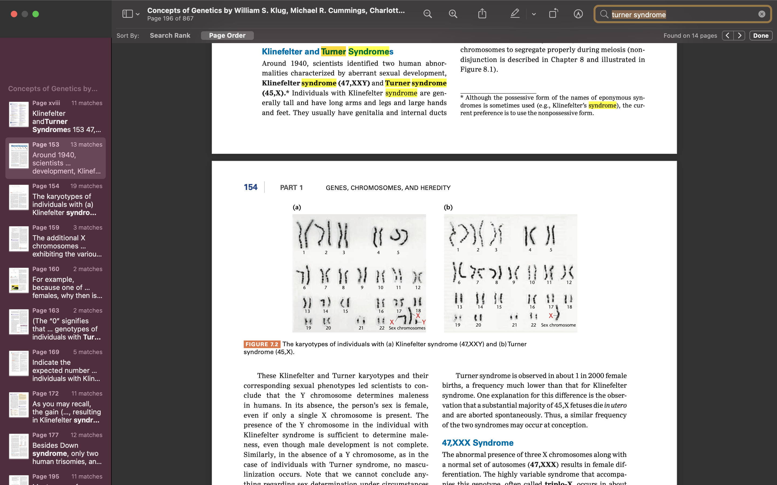
Monosomy
The loss of one chromosome produces a 2n - 1 complement called monosomy.
Turner syndrome (45,X)
In Drosophila, flies that are monosomic for the very small chromosome IV, develop more slowly, exhibit reduced body size, and have impaired viability. (Monosomy for chromosomes II and III is apparently lethal).
Reason for failure:
If just one of those genes is represented by a lethal allele, the unpaired chromosome condition will result in the death of the organism.
A single copy of a recessive gene may be insufficient to provide adequate function for sustaining the organism, a phenomenon called haploinsufficiency.
Aneuploidy is better tolerated in the plant kingdom, but less viable than their diploid derivatives.

Slide 5
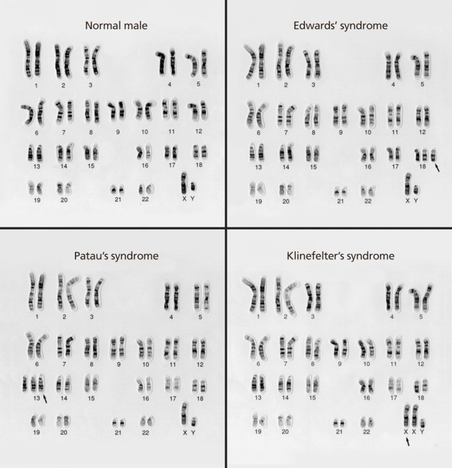
Trisomy
In general, the effects of trisomy (2n + 1) parallel those of monosomy. More viable individuals in both animal and plant.
The addition of a large autosome to the diploid complement in both Drosophila and humans has severe effects and is usually lethal during development.
In plants, trisomic individuals are viable, but their phenotype may be altered.

Slide 6
Syndromes
Down Syndrome
Klinefelter Syndrome
Patau Syndrome
Trisomy 21
XXY
Trisomy 13
Turner Syndrome
Edward Syndrome
Monosomy X
Trisomy 18

Slide 7
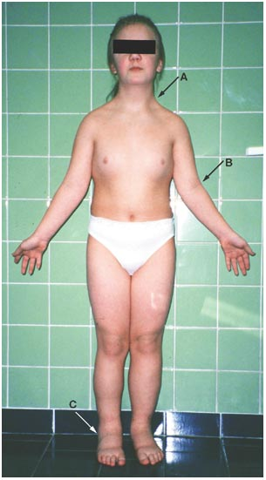
Turner Syndrome (Monosomy)
Turner syndrome (TS) or congenital ovarian hypoplasia syndrome.
The most common sex chromosomal abnormality affecting girls and women.
It’s a problem with one of the two X chromosomes.
Cause:
Turner syndrome happens when one of a female baby’s two X chromosomes is missing or incomplete. Researchers don’t yet understand why this happens.
Overview & Cause

Slide 8
Turner Syndrome (Monosomy)
01
Monosomy X
Each cell has only one X chromosome instead of two.
About 45%.
Mother’s egg or the father’s sperm randomly forming without an X chromosome.
Types
02
Mosaic Turner Syndrome
About 30% of Turner syndrome cases.
Some of the baby’s cells have a pair of X chromosomes, while other cells only have one.
03
Inherited Turner Syndrome
Their parent (or parents) were born with it and passed it on.
Usually happens because of a missing part of the X chromosome.

Slide 9
Turner Syndrome (Monosomy)
The main symptom of Turner syndrome is short stature. Almost all females with TS:
Grow slowly
Have delayed puberty (average adult height of 4 feet, 8 inches)
Another symptom is not experiencing typical sexual development. Most females with TS:
Don't experience breast development.
May not have menstrual periods
Have small ovaries that may only function for a few years or not at all.
Typically don't go through puberty
Don't make enough sex hormones
Besides short stature, females with Turner syndrome often have certain physical traits:
Broad chest
Cubitus valgus
Dental problems
Eye problems, such as a lazy eye or drooping eyelids.
Scoliosis
Low hairline at the back of the neck
Many skin moles
Missing knuckle in a particular finger or toe
Narrow fingernails and toenails
Small lower jaw
Swelling of the hands and feet
Symptoms

Slide 10
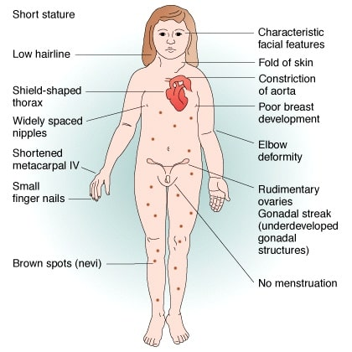
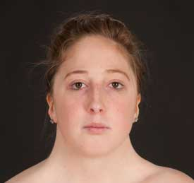
Turner Syndrome (Monosomy)
Symptoms

Slide 11
Turner Syndrome (Monosomy)
Turner syndrome (TS) treatment often focuses on hormones. Treatments may include:
Human growth hormone: Can increase height by several inches.
Estrogen therapy: Can help girls develop breasts and begin menstruation.
It can also help their uterus grow to a typical size.
Improves brain development, heart function, liver function
and skeletal health.
Cyclic progestins: Added at age 11 or 12 if blood tests note deficiency. Progestins will induce cyclic menstrual periods.
Treatment

Slide 12
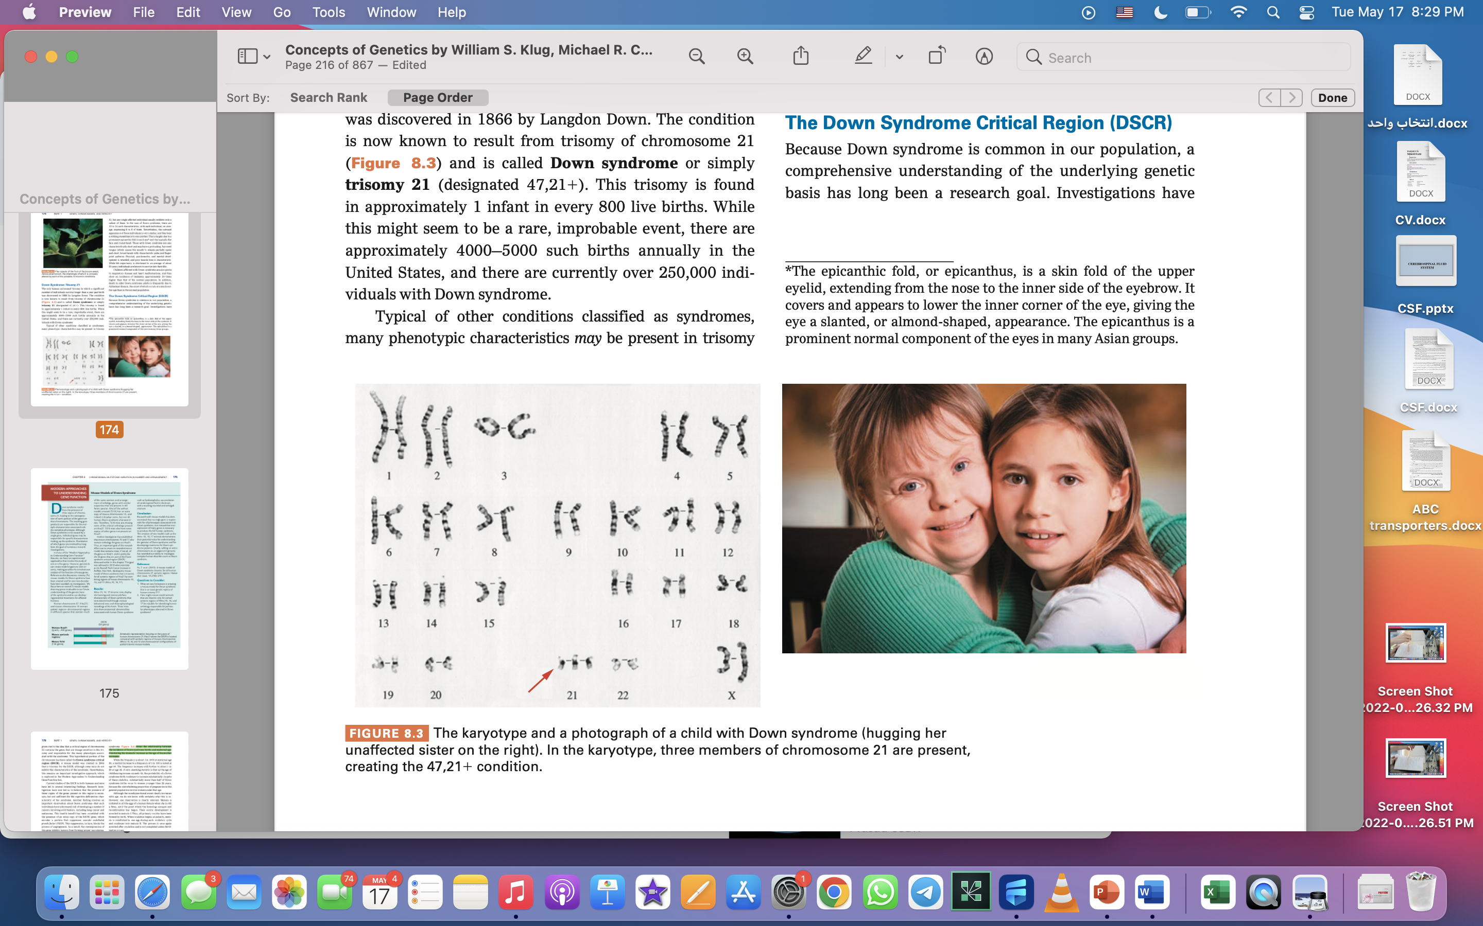
Down Syndrome (Trisomy 21)
The only human autosomal trisomy in which a significant number of individuals survive longer than a year past birth was discovered in 1866 by Langdon Down.
The condition is now known to result from trisomy of chromosome 21 and is called Down syndrome or simply trisomy 21 (designated 47,21+).
This trisomy is found in 1 infant in every 800 live births.
Overview

Slide 13
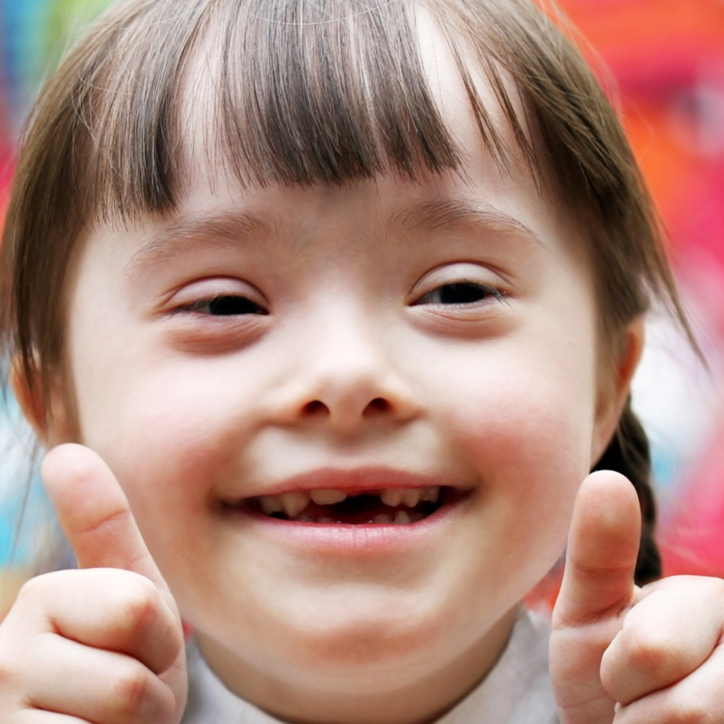
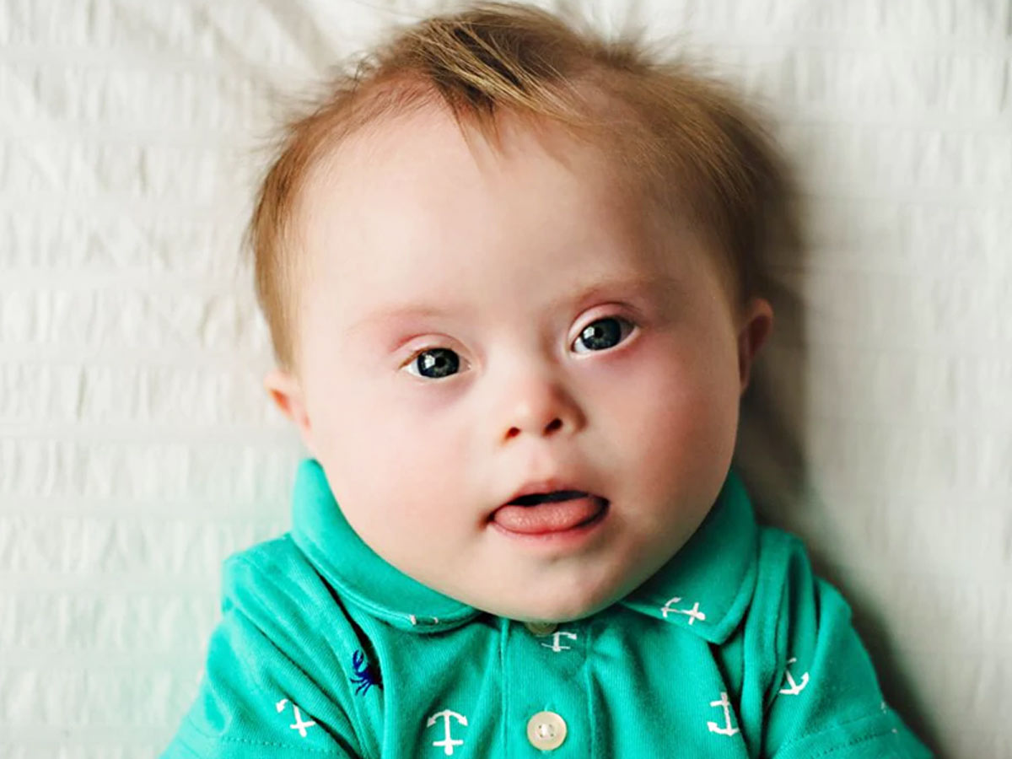
Down Syndrome (Trisomy 21)
Prominent epicanthic fold in each eye
Flat and round face.
Short
May have a protruding, furrowed tongue (which causes the mouth to remain partially open)
Short, broad hands with characteristic palm and fingerprint patterns.
Physical, psychomotor, and mental development is retarded
Poor muscle tone.
While life expectancy is shortened (average of about 50 years)
Prone to respiratory disease and heart malformations, and leukemia
Death in older Down syndrome adults is frequently due to Alzheimer disease
Symptoms

Slide 14
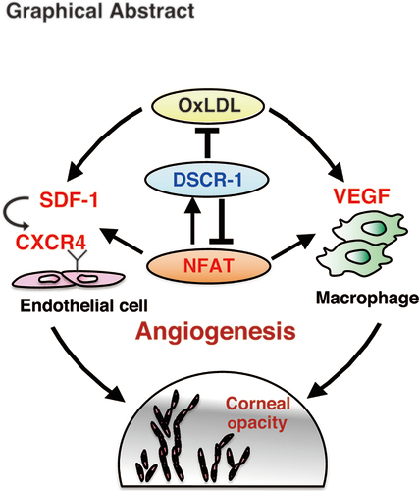
Down Syndrome (Trisomy 21)
A critical region of chromosome 21 contains the genes that are dosage sensitive and responsible for many phenotypes associated with the syndrome: Down syndrome critical region (DSCR).
The presence of three copies of the genes present in this region is necessary, but not sufficient for the cognitive deficiencies characteristic of the syndrome.
Decreased risk of developing a number of cancers involving solid tumors, including lung cancer and melanoma.
Correlated with the presence of an extra copy of the DSCR1 gene, which encodes a protein that suppresses vascular endothelial growth factor (VEGF). This suppression, in turn, blocks the process of angiogenesis.
Down syndrome critical region (DSCR).

Slide 15
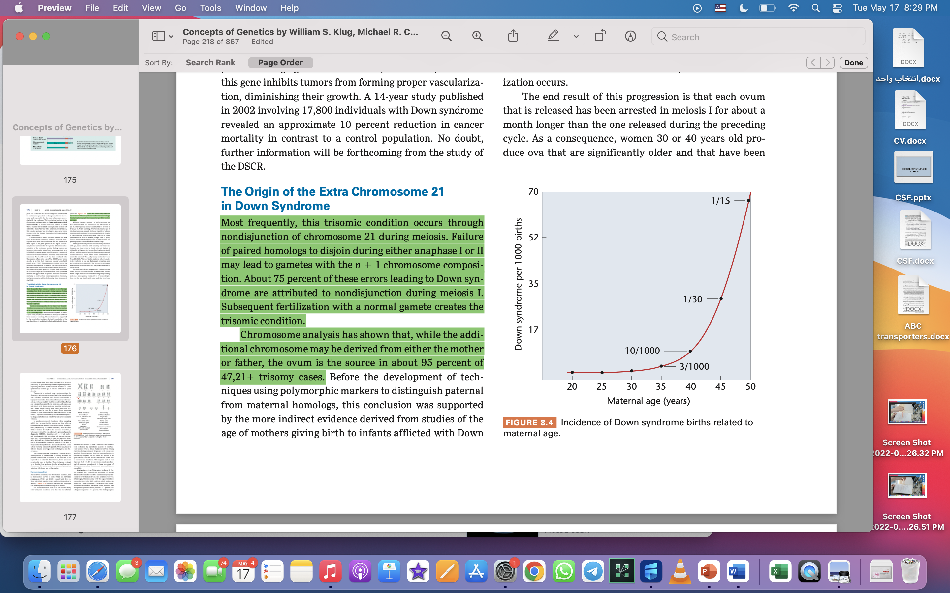
Down Syndrome (Trisomy 21)
Occurs through nondisjunction of chromosome 21 during meiosis. Either anaphase I or II.
Cause
About 75 percent during meiosis I.
The ovum is the source in about 95 percent of cases.
Down syndrome increase as the age of the mother increases.

Slide 16
Down Syndrome (Trisomy 21)
In amniocentesis and chorionic villus sampling (CVS):
fetal cells are obtained from the amniotic fluid or the chorion of the placenta, respectively.
Noninvasive prenatal genetic diagnosis (NIPGD):
fetal cells and DNA are derived directly from the maternal circulation.
After fetal cells are obtained and cultured, the karyotype can be determined by cytogenetic analysis. If the fetus is diagnosed as being affected, a therapeutic abortion is one option currently available to parents.
Diagnosis

Slide 17
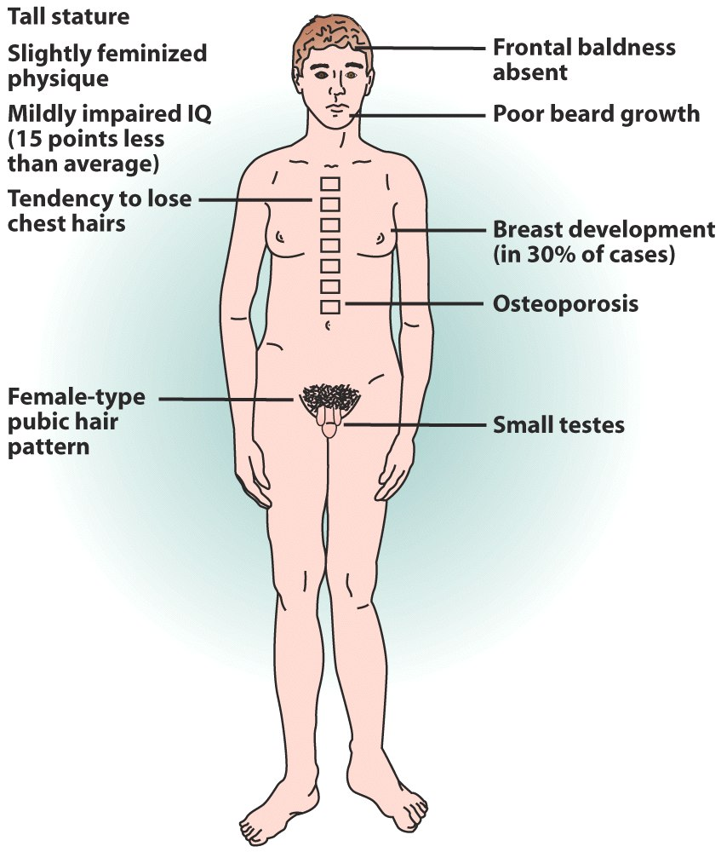
Klinefelter Syndrome (XXY)
Klinefelter syndrome is a chromosomal condition in boys and men that can affect physical and intellectual development. The condition results when a boy is born with an extra copy of the X chromosome.
It affects about 1 in 650 newborn boys.
Overview

Slide 18
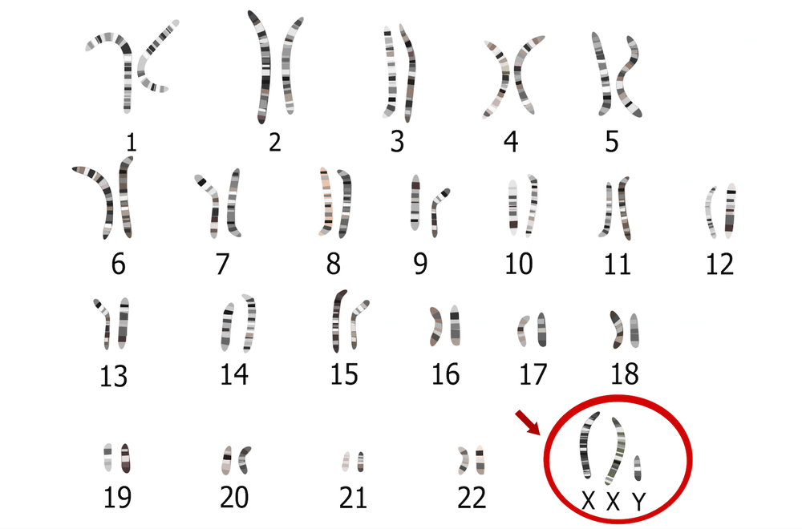
Klinefelter Syndrome (XXY)
Most often, boys and men with Klinefelter syndrome have the usual X and Y chromosomes, plus one extra X chromosome, for a total of 47 chromosomes (47,XXY). The activity of these extra genes may disrupt many aspects of development.
Causes
Klinefelter syndrome is not inherited; During cell division nondisjunction prevents X chromosomes from being distributed normally among reproductive cells as they form.

Slide 19
Klinefelter Syndrome (XXY)
Some people with features of Klinefelter syndrome have an extra X chromosome in only some of their cells; other cells typically have one X and one Y chromosome. In these individuals, the condition is described as mosaic Klinefelter syndrome (46,XY/47,XXY).
Several conditions resulting from the presence of more than one extra sex chromosome in each cell are sometimes described as variants of Klinefelter syndrome. These conditions include 48,XXXY syndrome, 48,XXYY syndrome, and 49,XXXXY syndrome.
Other Varieties

Slide 20
Klinefelter Syndrome (XXY)
Many boys with Klinefelter syndrome show few or only mild signs. The condition may go undiagnosed until adulthood or it may never be diagnosed.
Signs and symptoms of Klinefelter syndrome also vary by age;
Babies
Signs and symptoms may include:
Problems at birth, such as testicles that haven't descended into the scrotum
Slow motor development — taking longer than average to sit up, crawl and walk
Delay in speaking
Weak muscles
Symptoms

Slide 21
Klinefelter Syndrome (XXY)
Boys and teenagers
Signs and symptoms may include:
Absent, delayed or incomplete puberty
After puberty, less muscle and less facial and body hair compared with other teens
Small, firm testicles
Enlarged breast tissue (gynecomastia)
Learning disabilities, resulting in mild delays in speech and language development and problems with reading
Symptoms

Slide 22
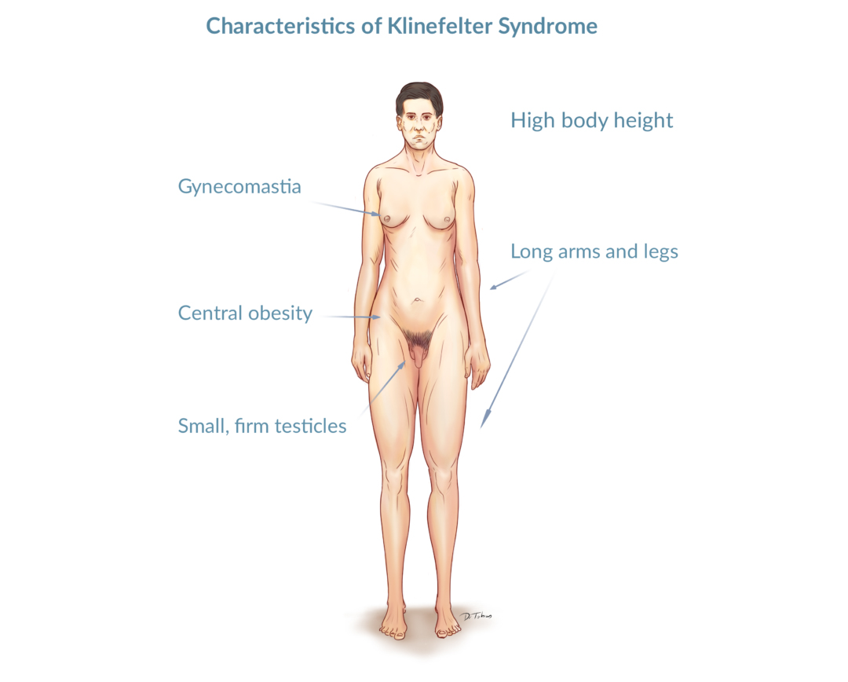
Klinefelter Syndrome (XXY)
Men
Signs and symptoms may include:
Low sperm count or no sperm
Small testicles and penis
Taller than average height
Weak bones
Nearly half of all men with Klinefelter syndrome develop metabolic syndrome, which is a group of conditions that include type II diabetes, high blood pressure (hypertension), increased belly fat, high levels of fats (lipids) such as cholesterol and triglycerides in the blood.
Symptoms

Slide 23
Klinefelter Syndrome (XXY)
Treatments
There's no cure for Klinefelter syndrome, but some of the problems associated with the condition can be treated if necessary.

Slide 24
Patau Syndrome (Trisomy 13)
Trisomy 13, also called Patau syndrome, is a chromosomal condition associated with severe intellectual disability and physical abnormalities in many parts of the body.
Due to the presence of several life-threatening medical problems, many infants with trisomy 13 die within their first days or weeks of life. Only five percent to 10 percent of children with this condition live past their first year.
Trisomy 13 occurs in about 1 in 16,000 newborns.
Overview

Slide 25
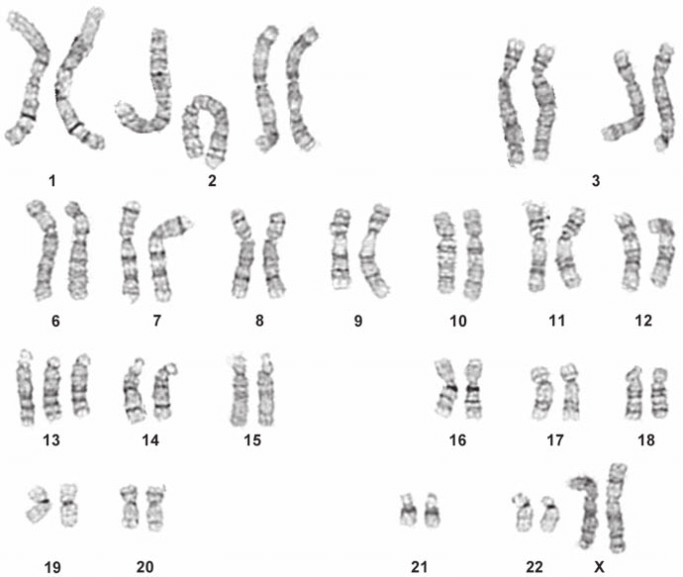
Patau Syndrome (Trisomy 13)
Most cases of trisomy 13 are not inherited and result from having three copies of chromosome 13 in each cell in the body instead of the usual two copies.
An error in cell division called nondisjunction results in a reproductive cell with an abnormal number of chromosomes.
Causes

Slide 26
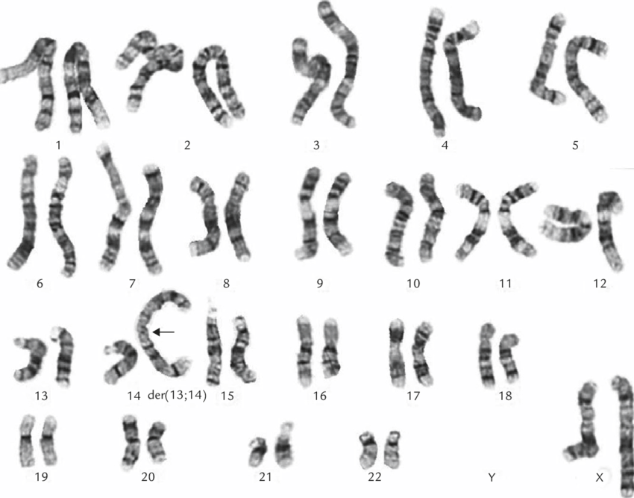
Patau Syndrome (Trisomy 13)
Trisomy 13 can also occur when chromosome 13 becomes attached (translocated) to another chromosome during the formation of reproductive cells (eggs and sperm) or very early in fetal development.
Translocation trisomy 13 can be inherited.
An unaffected person can carry a rearrangement of genetic material between chromosome 13 and another chromosome. These rearrangements are called balanced translocations because there is no extra material from chromosome 13. Affected people have two normal copies of chromosome 13, plus an extra copy of chromosome 13 attached to another chromosome. In rare cases, only part of chromosome 13 is present in three copies.
Causes

Slide 27
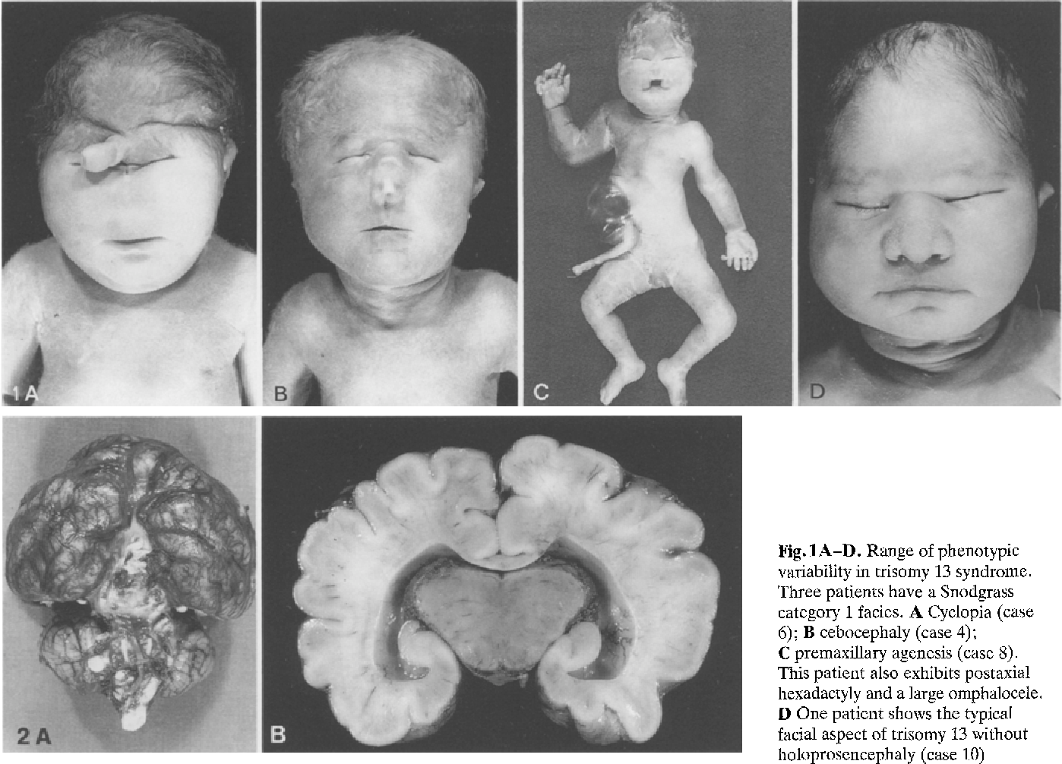
Patau Syndrome (Trisomy 13)
The extra 13th chromosome causes severe mental and physical problems including:
Underdeveloped nose or nostrils
Cleft lip or palate
Extra fingers or toes (polydactyly)
Brain or spinal cord abnormalities
Undescended testes
Absence of 1 or both eyes (anophthalmia)
Reduced distance between the eyes (hypotelorism)
Smaller than normal head size (microcephaly)
Skin missing from the scalp (cutis aplasia)
Ear malformations and deafness
Symptoms

Slide 28
Patau Syndrome (Trisomy 13)
Babies born with trisomy 13 can have many health problems, and more than 80% don’t survive more than a few weeks. Those that do can have serious complications including:
Breathing difficulties
Hearing loss
High blood pressure
Intellectual disabilities
Neurological problems
Pneumonia
Seizures
Slow growth
Trouble feeding or digesting food
Symptoms

Slide 29
Patau Syndrome (Trisomy 13)
There is no cure for trisomy 13, and treatments focus on baby’s symptoms. These can include surgery and therapy. Trisomy 13 isn’t always fatal. But doctors can’t predict how long a baby might live if they don’t have any immediate life-threatening problems. However, babies born with trisomy 13 rarely live into their teens.
Treatments

Slide 30
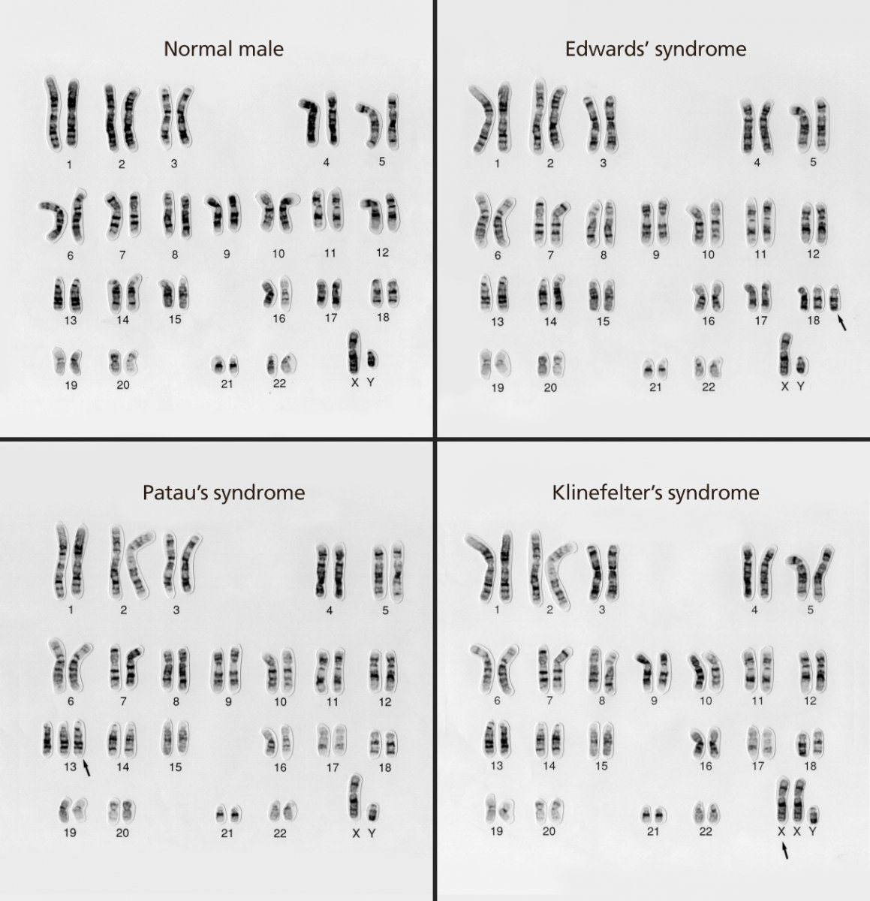
Edward Syndrome (Trisomy 18)
Edwards syndrome, is a very severe genetic condition that affects how your child’s body develops and grows. Children diagnosed with trisomy 18 have a low birth weight, multiple birth defects and defining physical characteristics.
The condition occurs when a person has an extra copy of chromosome 18, which is random and unpredictable. The likelihood increases with maternal age at the time of pregnancy.
Edwards syndrome occurs in an estimated 1 out of every 5,000 to 6,000 live births. The condition is more common during pregnancy (1 out of every 2,500 pregnancies), but most (at least 95%) fetuses don’t survive, so pregnancies can end in miscarriage or babies are stillborn.
Overview & Cause

Slide 31
Edward Syndrome (Trisomy 18)
Symptoms of Edwards syndrome during pregnancy
Very little fetal activity.
A single artery in umbilical cord.
A small placenta.
Birth defects.
fetus is surrounded by too much amniotic fluid (polyhydramnios).
Characteristics of Edwards syndrome after birth
Decreased muscle tone (hypotonia).
Low-set ears.
Internal organs forming or functioning differently (heart and lungs).
Issues with cognitive development (intellectual disabilities), which are typically severe.
Overlapping fingers and/or clubfeet.
Small physical size (head, mouth and jaw).
Weak cry and minimal response to sound.
Symptoms
Severe symptoms of Edwards syndrome (trisomy 18)
Congenital heart disease and kidney disease (present at birth).
Breathing abnormalities (respiratory failure).
Gastrointestinal tract and abdominal wall issues and birth defects.
Hernias.
Scoliosis.
Issues relating to the heart and respiratory failure affect nearly 90% of children (cause of death)

Slide 32
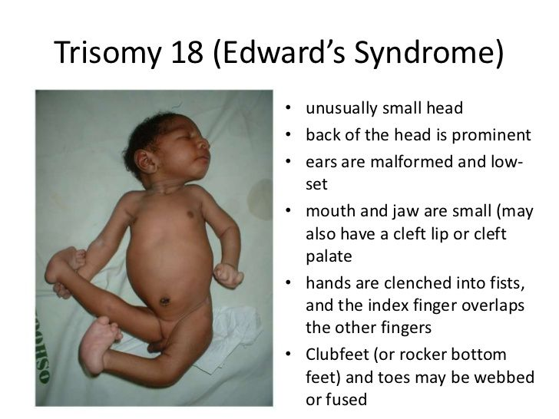
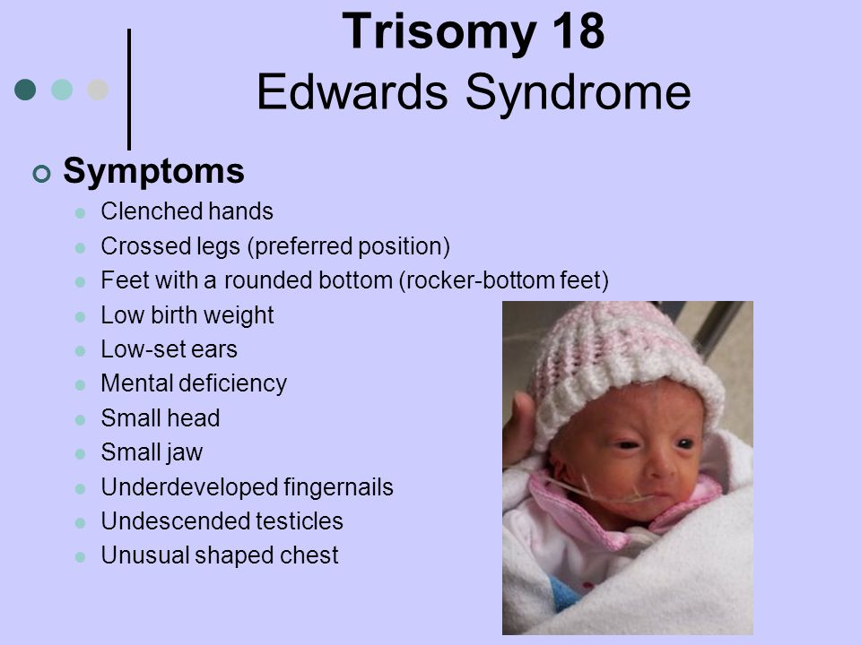
Edward Syndrome (Trisomy 18)
Symptoms

Slide 33
Edward Syndrome (Trisomy 18)
Often, the condition is so severe that babies who survive being born are treated with comfort care. But treatment for Edwards syndrome (trisomy 18) is unique for each child, based on the severity of their diagnosis. There’s no cure for Edwards syndrome (trisomy 18).
Treatment

Slide 34
References
[1] Shaffer, L., & Theisen. (2010). Disorders caused by chromosome abnormalities. The Application of Clinical Genetics, 159.
[2] Pass, K. A., Bartoshesky, L. E., Harris, K. B., Fredrick, B. L., Tullis, K., Ac Pe R S O N N E L, M., Hawkins, A., Rifaey, H., Terry, E., Waite, M., Wise, L., Dolan, S. M., Djurdjinovic, L., Faucett, W. A., Green, N., Hoffman, M., Lea, D. H., Lloyd-Puryear, M. A., & Weiss, J. O. (n.d.). The New York-Mid-Atlantic Guide for Patients and Health Professionals was produced thanks to a partnership between Genetic Alliance and NYMAC, the New York-Mid-Atlantic Consortium for Genetic and Newborn Screening Services.
[3] https://www.osmosis.org/answers/chromosomal-aberrations
[4] https://www.slideshare.net/antoniogalascience/chromosomal-abnormalities-46953257
[5] https://www.yourgenome.org/facts/what-is-a-chromosome-disorder
[6] https://my.clevelandclinic.org/health/diseases/15200-turner-syndrome
[7] https://www.nhs.uk/conditions/klinefelters-syndrome/
[8] https://www.nhs.uk/conditions/pataus-syndrome/
[9] https://medlineplus.gov/genetics/condition/klinefelter-syndrome/
[10] https://www.webmd.com/children/trisomy-13
[11] https://www.webmd.com/men/klinefelter-syndrome

